Slide 1
An exploration of customer information
AXIS
INSURANCE
Key insights &
business decisions

Slide 2
OBJECTIVES
1
Medical claims of smokers vs. non-smokers
Are the mean charges claimed by smokers higher than those claimed by non-smokers?
2
BMI of females vs. males
Are the BMIs of males and females statistically different from one another?
3
Proportion of smokers by region
Is the proportion of smokers statistically different in each region of the country?
4
BMI of women based on number of children
Is the mean BMI of women statistically different based on the number of children they have?

Slide 3
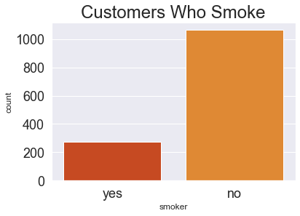
1
Medical claims of smokers vs. non-smokers
• 1,338 customers were analyzed.
• 274 customers smoke (20.5%)
• 1,064 do not smoke (79.5%)

Slide 4
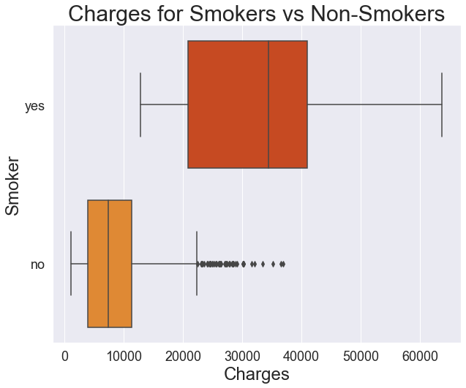
1
Medical claims of smokers vs. non-smokers
• 75% of customers who smoke have claims of approximately $21,000 or more.
• 75% of customers who do not smoke have claims of approximately $12,000 or less.

Slide 5
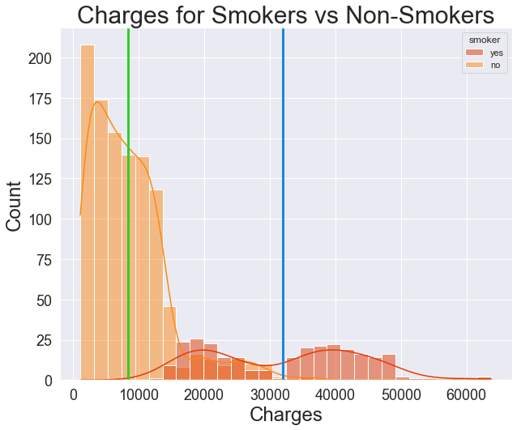
1
Medical claims of smokers vs. non-smokers
• The average claim of a smoker is $32,050.23.
• The average claim of a non-smoker is $8,434.27.

Slide 6
1
Medical claims of smokers vs. non-smokers
• Let µ₁ equal the mean claim value of a smoker
• Let µ₂ equal the mean claim value of a non-smoker
• Let the significance level be α = 0.05
• Null Hypothesis: • Alternative Hypothesis:
H₀: µ₁ = µ₂ H_{a}: µ₁ > µ₂
• Using a two independent sample t-test for equality of means, we find a p-value of 2.9 ✕ 10⁻¹⁰³. Therefore, we reject the null hypothesis.

Slide 7
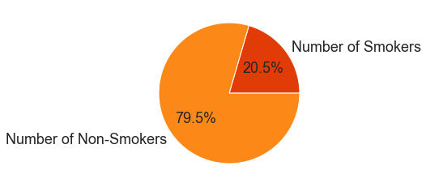
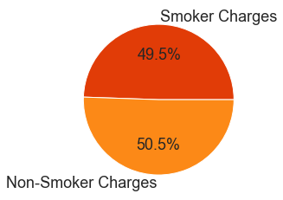
1
Medical claims of smokers vs. non-smokers
• Charges for smokers are statistically greater than the charges for non-smokers.
• Total claims from smokers account for almost 50% of total charges claimed, even though smokers account for only 20.5% of our customers.
• Therefore, we should consider increasing the premiums of smokers to compensate for the cost of insuring them.

Slide 8
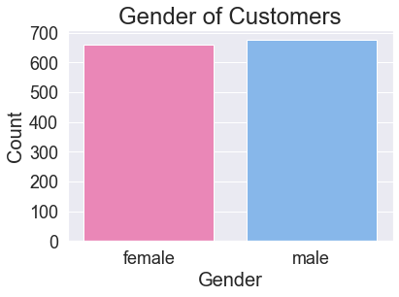
2
BMI of females vs. males
• 1,338 customers were analyzed.
• 662 customers are female (49.5%)
• 676 customers are male (50.5%)

Slide 9
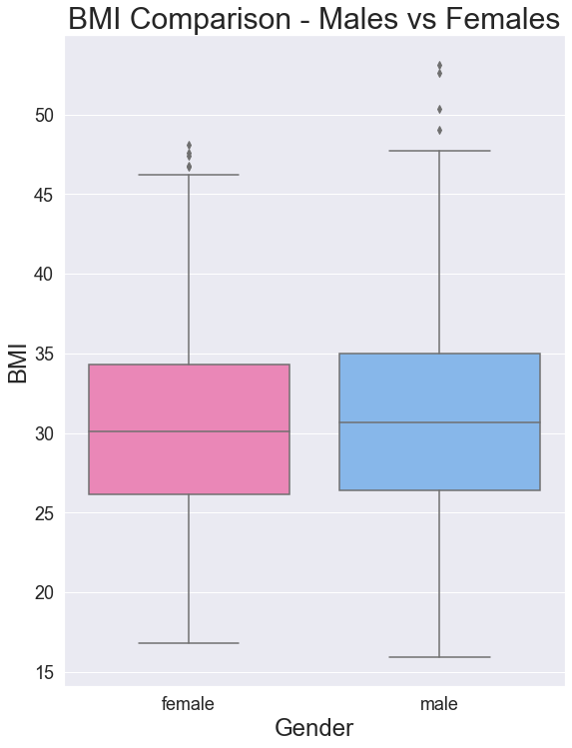
2
BMI of females vs. males
• Median BMI:
Female = 30.1
Male = 30.7
• Middle 50%:
Female = 26.1–34.3
Male = 26.4 –35.0
• Lowest BMI:
Female = 16.8
Male = 16.0
• Highest BMI:
Female = 48.1
Male = 53.1
• Conclusion:
The BMIs of males and females appear to be quite similar.

Slide 10
2
BMI of females vs. males
• Let µ₁ equal the mean BMI of a female customer
• Let µ₂ equal the mean BMI of a male customer
• Let the significance level be α = 0.05
• Null Hypothesis: • Alternative Hypothesis:
H₀: µ₁ = µ₂ H_{a}: µ₁ ≠ µ₂
• Using a two independent sample t-test for equality of means, we find a p-value of 0.0899. Therefore, we fail to reject the null hypothesis.

Slide 11
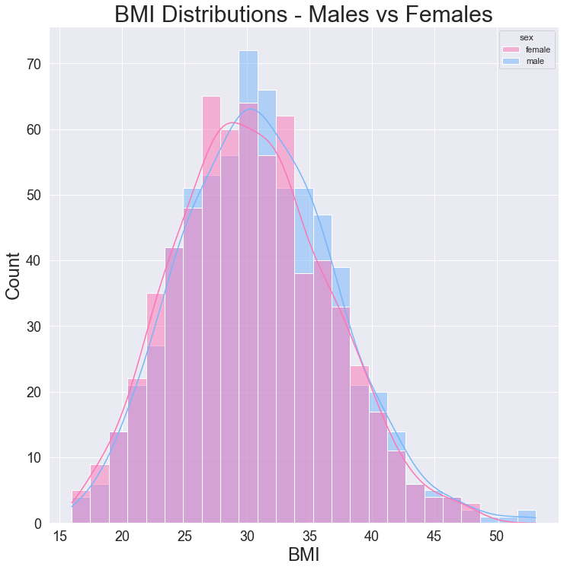
2
BMI of females vs. males
• Hypothesis testing confirm that the mean BMIs of male customers are statistically equal to the mean BMIs of female customers.

Slide 12
3
Proportion of smokers by region
Smoker
Non-smoker
TOTAL
Northeast
67
257
324
Northwest
58
267
325
Southeast
91
273
364
Southwest
58
267
325
TOTAL
274
1064
1338

Slide 13
3
Proportion of smokers by region
• Each region appears to have relatively equal proportions of smokers vs non-smokers:
• Northeast: 20.7% smoke, 79.3% do not smoke
• Northwest: 17.8% smoke, 82.2% do not smoke
• Southeast: 25.0% smoke, 75.0% do not smoke
• Southwest: 17.8% smoke, 82.2% do not smoke

Slide 14
3
Proportion of smokers by region
• Let the significance level be α = 0.05
• Null Hypothesis:
H₀: Smoking preference is independent of region
• Alternative Hypothesis:
H_{a}: Smoking preference is not independent of region
• Using a chi-squared test for independence, we find a p-value of 0.0617. Therefore, we fail to reject the null hypothesis.

Slide 15
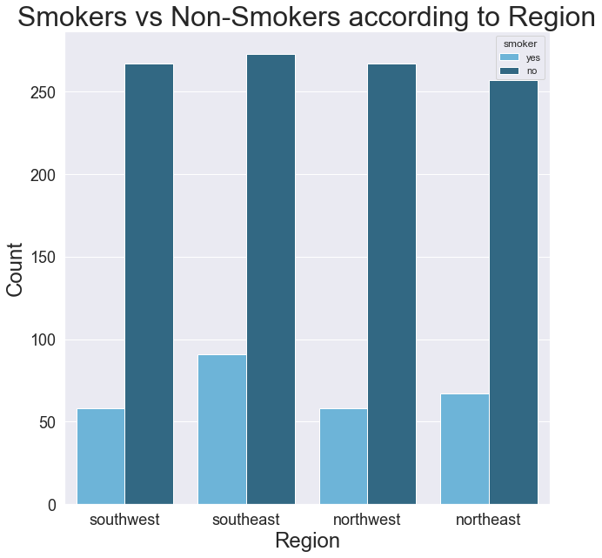
3
Proportion of smokers by region
• Hypothesis testing confirms that the proportion of smokers is independent of region.
• Therefore, we conclude that the proportion of smokers is not significantly different across regions.

Slide 16
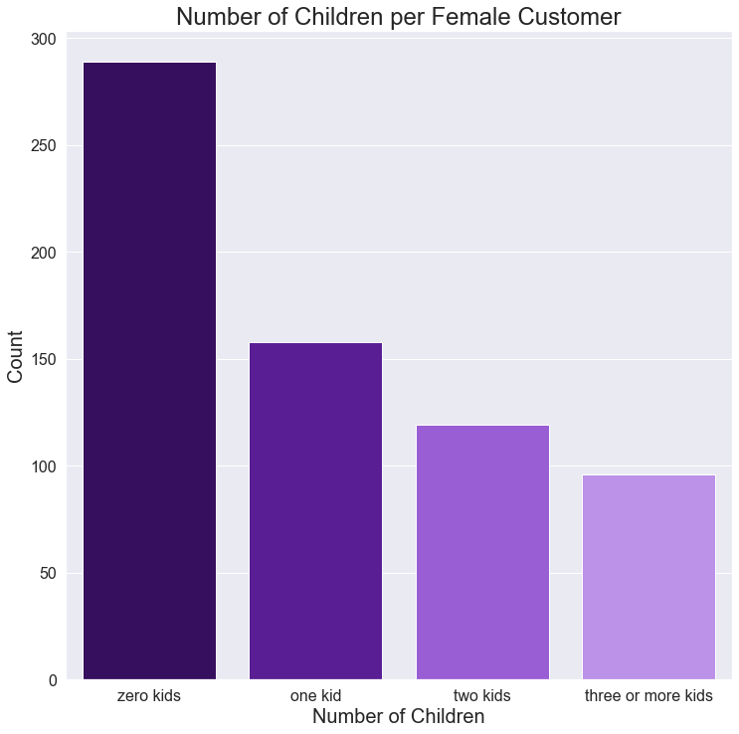
4
BMI of women based on number of children
• 662 female customers
• 289 have zero children
(43.7%)
• 158 have one child
(23.9%)
• 119 have two children
(17.9%)
• 96 have three+ children
(14.5%)

Slide 17
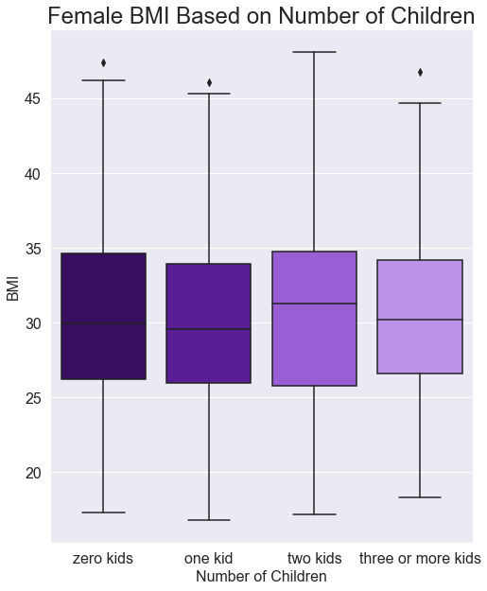
4
BMI of women based on number of children
• 0 children
Min: 17.3
Median: 29.9
Mean: 30.4
Max: 46.09
• 1 child
Min: 16.8
Median: 29.6
Mean: 30.1
Max: 46.09
• 2 children
Min: 17.2
Median: 31.3
Mean: 30.6
Max: 48.1
• 3+ children
Min: 18.3
Median: 30.2
Mean: 30.6
Max: 46.8

Slide 18
4
BMI of women based on number of children
• Let µ₀ equal the mean BMI of a female customer with zero children
• Let µ₁ equal the mean BMI of a female customer with one child
• Let µ₂ equal the mean BMI of a female customer with two children
• Let µ₃ equal the mean BMI of a female customer with 3+ children
• Let the significance level be α = 0.05
• Null Hypothesis:
H₀: µ₀ = µ₁ = µ₂ = µ₃
• Alternative Hypothesis:
H_{a}: At least one of the means listed in H₀ is not equal to the others
• Using an ANOVA test, we find a p-value of 0.84. Therefore, we fail to reject the null hypothesis.

Slide 19
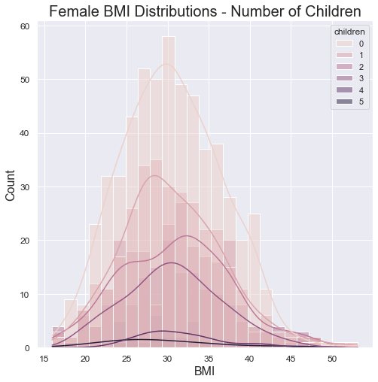
4
BMI of women based on number of children
• Hypothesis testing confirms that the mean BMIs of women with 0, 1, 2, or 3+ children are statistically equal.

Slide 20
CONCLUSIONS
1
Medical claims of smokers vs. non-smokers
Mean charges claimed by smokers are statistically higher than those of non-smokers.
2
BMI of females vs. males
The mean BMIs of males are statistically equal to the mean BMIs of females.
3
Proportion of smokers by region
The proportion of smokers is not statistically different in each region of the country.
4
BMI of women based on number of children
Is the mean BMIs of women with zero, one, two, or three+ children are statistically equal.

